Slide 1
Arduino Control Statements
Arduino If statement
The if ( ) statement is the conditional statement, which is the basis for all types of programming languages. If the condition in the code is true, the corresponding task or function is performed accordingly. It returns one value if the condition in a program is true. It further returns another value if the condition is false.
It means that if ( ) statement checks for the condition and then executes a statement or a set of statements.
Let's understand the concept with the help of a flow chart.

Slide 2
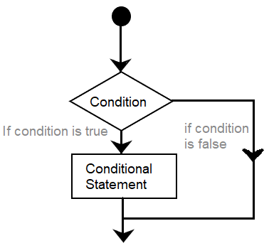
It clearly explains the process of execution of a statement. If the condition is False, it comes out of the if ( ) statement. If the condition is true, the function is performed.
The if ( ) statement is written as:
1. if ( condition)
2. {
// include statements
// if the condition is true
// then performs the function or task specified inside the curly braces
}

Slide 3
Here,
condition = It includes the boolean expressions, that can be true or false.
We can also use one or more operators inside the parentheses. The comparison operators that can be used as a condition inside the parentheses are listed below:
a ! = b (a not equal to b)
a < b (a less than b)
a > b (a greater than b)
a = = b (a equal to b)
a < = b (a less than or equal to b)
a > = b (a greater than or equal to b)
where a and b are the variables.
Code Examples
Let's understand with the help of two coding examples.

Slide 4
Example 1:
int a = 6; // initiaization of values to variables a and b
int b = 4;
void setup() 4. {
5. Serial.begin(9600); 6. }
7. void loop() 8. {
9. if (a > b )
10. {
11. Serial.println( " a is greater than b ");
12. }
13. if (b > a )
14. {
15. Serial.println( " b is greater than a ");
16. }
17. }

Slide 5
Output: a is greater than b
The code shows the initialization of values to the two variables a and b. In this example, the first condition is True. Hence the corresponding information is printed.
Example 2:
Consider the below code.
const int LED1 = 2;
const int LED2 = 13;
int x = 80 ;
void setup ( )
{
Serial.begin( 9600 );
pinMode ( LED1, OUTPUT);
pinMode ( LED2, OUTPUT);
}

Slide 6
10. void loop ( )
11. {
12. if ( x > 100 )
13. {
14. digitalWrite(LED1, HIGH);
15. delay (500);
16. }
17. if ( x < 100 )
18. {
19. digitalWrite(LED2, HIGH);
20. delay (500);
21. }
22. }
The example is of two LEDs. In the above example, we have initialized the value of x. Since the value of x is less than 100, the second condition is true. Hence, LED2 will light up. If the value of x is greater than 100, LED1 will light.

Slide 7
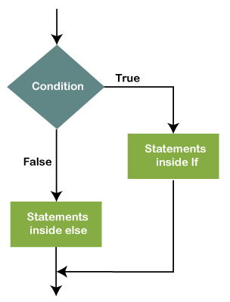
Similarly, we can use the if statement according to our requirements.
Note: We should be careful while using the = (equal) sign. For example, x = 5. It is the assignment operator, where value 5 will be assigned to the variable x. Instead, we need to use x = = 5, as it is a comparison operator.
Arduino if-else and else-if
The else and else-if both are used after specifying the if statement. It allows multiple conditions
to be grouped.
If else. The if-else condition includes if ( ) statement and else ( ) statement.
The condition in the else statement is executed if the result of the if ( )
statement is false.
The flowchart is shown below:

Slide 8
Let's understand with an example.
1. if (condition)
2. {
3. // statements
4. }
5. else
6. {
//statements
}
The else( ) statement can also include other if statements. Due to this, we can run multiple statements in a single program.

Slide 9
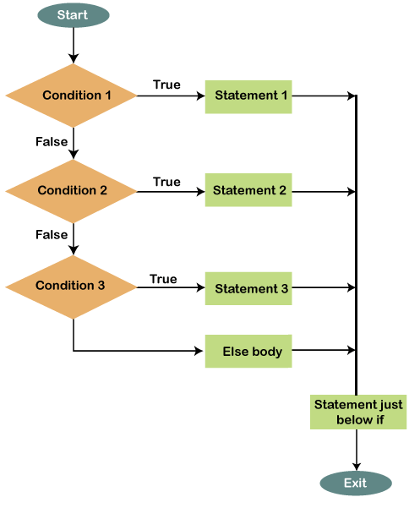
The flowchart is shown below:

Slide 10
Code Examples
Example 1:
Consider the below code.
int a = 5;
int b= 6;
void setup ( ) {
4. Serial.begin( 9600 );
}
void loop () {
if ( a > b ) {
Serial.println("a is greater ");
} else {
Serial.println("a is smaller" );
}
}

Slide 11
In the above example, the values are initialized to the variables a and b. The message concerning the satisfied condition will be printed.
Example 2:
Consider the below code.
1. const int LED1 = 4;
2. int x = 150 ;
3. void setup ( ) 4. {
Serial.begin( 9600 );
pinMode ( LED1, OUTPUT); 7. }
8. void loop ( )
9. {
10. if ( x > 100 )
11. {
digitalWrite(LED1, HIGH);
Serial.println ( " LED1 will light +++");

Slide 12
14. delay (500);
15. }
16. else
17. {
18. Serial.println ( "LED1 will not light");
19. }
20. }
Output:
LED1 will light +++
If the initialized value of x is less than 100, the message ' LED1 will not light ' will be printed in the output.

Slide 13
Else if. The else if statement can be used with or without the else ( ) statement. We can include multiple else if statements in a program. Let's understand with an example.
1. if (condition)
2. {
3. // statements
4. }
5. else if ( condition)
6. {
// statements
// only if the first condition is false and the second is true
}
10. else
11. {
12. //statements
13. }

Slide 14
Code Example
Let's understand else-if statement with the help of an example.
Example 1:
Consider the below code.
int i = 2;
int j = 3;
void setup ( ) 4. {
5. Serial.begin(9600);
6. }
7. void loop ( ) 8. {
9. if ( i > j )
10. {
11. Serial.println( " I is greater ");
12. }

Slide 15
13. else if ( i < j )
14. {
15. Serial.println( " J is greater " );
16. }
17. else
18. {
19. Serial.println( " Both are equal " );
20. }
21. }
Output: J is greater
The else if ( ) statement will stop the flow once its execution is true.
What is the difference between Else and Else If?
The Else ( ) part is executed if one or all the If ( ) conditions present in the code comes out to be false. The else if ( ) will stop the program flow if it becomes true.

